Slide 1

Components of fitness and Well-being
Role of the Cardio-vascular system

Slide 2
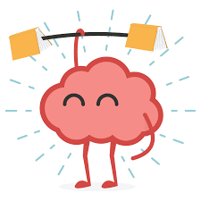
Maintaining brain health and plasticity throughout life is an important public health goal, and it is increasingly clear that exercise can help us to achieve it
Brain plasticity, can be defined as the ability of the nervous system to change its activity in response to intrinsic or extrinsic stimuli by reorganizing its structure, functions, or connections.

Slide 3
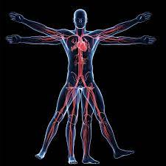
What is the difference between anatomy and physiology?
Instruction: Stand up straight and take a deep breath
What happened?
activated around 302 muscles to stand up
26 bones in the spinal column shifted to lift the head and align your neck with the rest of the back
Multiple other systems engaged to move you
Fitness is subjective to one’s
medical history,
current health status,
socio-economic status,
nutrition,
sporting aspirations,
past training.
In addition -
Emotional,
mental and
spiritual dimensions
Anatomy: Refers to the bones and muscle systems along with other structural parts in the body
Physiology: Interaction of these bones and muscles along with nerves, tendons, other structures of body working in synchrony to assist in different functions – standing, walking, bending, eating, breathing etc. It explores how your body functions

Slide 4

Fitness components
Fitness can be broken down into 2 strata: health-related and skill-related components
Health related fitness components have the potential to impact one’s quality of life
Cardiovascular endurance →capability of the heart, lungs, and circulatory system to take in, absorb, and use oxygen
Muscular endurance →capacity of a muscle/group of muscles working together, to maintain continued contractions against a low or moderate resistance
Strength →force effectiveness of a muscle or a group of muscles.
Flexibility → mobility of the joints and their associated soft-tissue structures
Body composition → the proportional segmentation of body weight into lean and fat constituents

Slide 5
Skill-related fitness components are desirable for many sporting activities, but a deficiency in these won’t negatively impact your health, as with health-related components of fitness
Fitness components:
Agility → ability to change direction of the body or parts of the body, incorporating elements of deceleration and acceleration
Balance → ability to maintain both static and dynamic equilibrium of the body parts as well as the whole body
Coordination → ability to perform a range of simple to complex movements with precision, timing, and continuity
Power → ability to achieve optimal force development of the voluntary muscles—but in a minimal time period
Reaction speed → ability to recruit selected neuromuscular responses with a minimal time delay

Slide 6
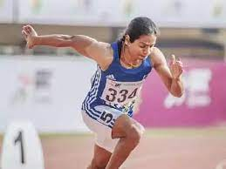
The need for different Exercise programs
There are many influences on total fitness, and thus different ways of exercising
A program designed to improve only one of these components won’t satisfy the others
The American College of Sports Medicine recommends:
About 30 minutes of exercise at medium intensity for 5 days/wk
or 20 minutes at high intensity for 3 days per week
For weight loss 60 minutes of exercise at a time
Even 15 minutes can have a significant impact, to build up as the body strengthens
Cardiovascular Endurance: also referred to as cardiorespiratory fitness (CV), cardio, stamina, and aerobic fitness—is improved through specific activity that usually involves number of large muscle groups and is sustained for a certain length of time
Eg: aerobics, jogging, and cycling

Slide 7
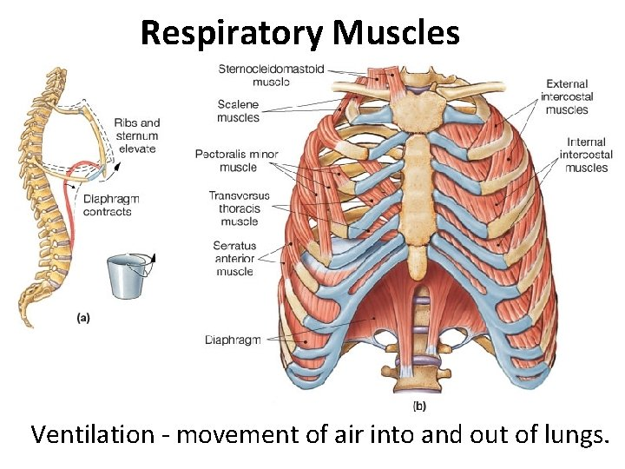

What happens to the body when one exercises?
O2 inspiration is the beginning of the process of exercise
In response to the increased demands of exercise → body absorbs more oxygen
With time, the diaphragm, intercostal muscles, and pectoralis minor that control respiration all become more efficient and able to work longer at higher intensities
Lungs don’t actually become larger

Slide 8
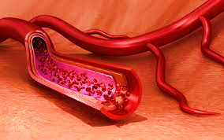
What happens to the body when one exercises?
Oxygen is transported in the blood as we breathe – increasing the total blood volume and the concentration of red cells (the carriers of the oxygen)
Over time, the body grows more capillaries to deliver more oxygen faster and more efficiently
The blood takes the oxygen to the heart through the pulmonary veins, and then it is pumped around the whole body
Working out leads to the heart being able to hold more blood.
The wall of the heart becomes stronger. An increased amount of blood is ejected with each beat. The body is then able to accommodate higher intensities of exercise
A by-product is that the stronger heart will not have to work as hard when resting, so the resting pulse drops with exercise
Within the muscle cells, mitochondria break down food for fuel, use the oxygen delivered by the blood to do their work
The number and size of these mitochondria increase so that the muscles can use more oxygen and sustain greater effort for longer periods of time
Exercise changes the way fats are transported in the blood by increasing the ratio of high-density lipoproteins (HDL), the “good” cholesterol, to low-density lipoproteins (LDL), the “bad” cholesterol
https://www.youtube.com/watch?v=Ovk5qEQ9vmw

Slide 9
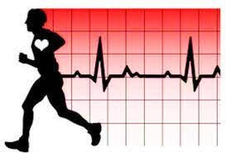
How to gain from Cardio? Golden rules
Begin with a warm-up that involves gentle and flowing movements of the major limbs. Start with small and gradually increases in amplitude and effort, and work through all the joints
The workout phase features continuous, rhythmic movement that maintains an intensity of between 55% and 90% of your maximum heart rate—which can be estimated by subtracting your age from 220—for between 20 and 60 minutes, depending on your current fitness level
The final phase is a cooldown that involves incrementally lowering the intensity of your workout. A sudden stop may cause fainting due to the blood pooling in your muscles and to the reduction in the amount of oxygen that is reaching your brain. The cooldown can be followed by some stretching for the major muscle groups

Slide 10
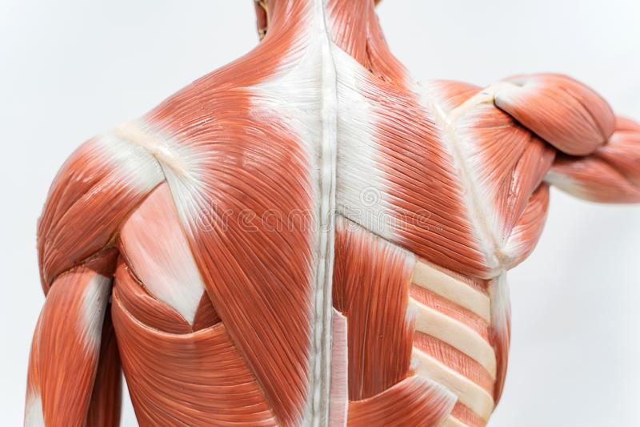

Muscular Endurance and Strength
Muscular endurance and strength are different health-related fitness components, but they functionally complement each other; there is a continuum that ranges from strength at one end to endurance at the other end
CDC recommends endurance and strength training twice weekly
Muscular endurance – fueled by the lactate system (supplying energy gradual builds up lactic acid in the muscle). Regular exercise improves the supply of oxygen so that you’re able to perform for a longer amount of time before lactic acid builds up
Muscular strength – training leads to microscopic tears to the tissues at the cellular level. Ingesting sufficient protein and resting builds the adaptive process of super-compensation, leading to increase in the cross-sectional muscle size and a corresponding increase in strength
Muscular endurance and strength training have been proven to increase bone density, which reduces the risk of osteoporosis; increases metabolic rate, assisting in weight management; reduces blood pressure; decreases LDL; and raises HDL. Muscular endurance and strength training also improve posture, thereby reducing the risk of lower back malady and the risk of injury from events such as falls
Women will grow bulging muscles with strength training
The degree to which muscles grow is dependent upon testosterone levels, which explains the different responses between men and women with this type of training. In general, men who lift weights increase muscle size, but women improve their tone and appear leaner

Slide 11

Muscular Endurance and Strength
To improve muscular endurance and strength, warm up to be done by performing basic resistance training movements but with no resistance
Desirable → a minimum frequency of 2 times/week and 1 to 3 sets of 5 strength and 25 endurance repetitions—resting for 30 to 60 seconds between sets and allowing 30 to 45 minutes for each session
Cool down with some stretches for the muscle groups worked in the session

Slide 12
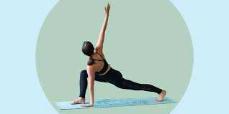
Flexibility
Divided into static and dynamic classifications, and a good score in one doesn’t necessarily imply the same in the other
Static flexibility → slowly lengthening a muscle, by natural movement or by adding external pressure at the end point and then holding the position
Dynamic flexibility → range that can be achieved through movement, in which the muscle is continuously lengthened and shortened but is not held at an end point. Movement must be controlled because dynamic flexibility carries an injury risk if it causes an overstretching of the muscle’s capability
The American College of Sports Medicine recommends including flexibility training 3 times per week
Eg: Yoga, dance
the rate of improvement is greater at a younger age
Improvements in flexibility → a developmental stretch
Flexibility improves with developmental stretch - A static stretch carefully applied and aims to lengthen the elastic muscle beyond its original length
Notes:
The most undervalued component in exercise

Slide 13
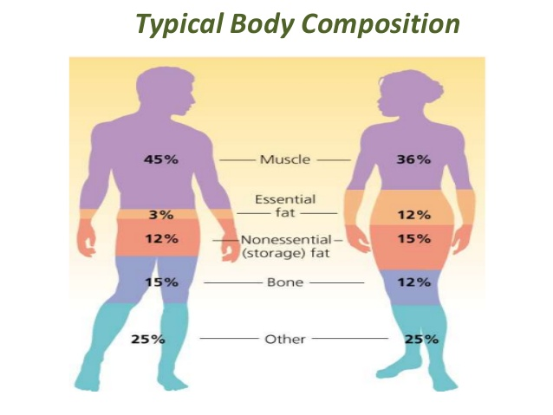
Body Composition
To assess the percentage of our body weight that’s attributed to fat. The medical community universally agrees that excess body fat can lead to increased risk of diabetes, cardiovascular disease, joint problems, respiratory issues, and high blood pressure
Lean body weight—muscles and bones—are more dense than fat. This explains why someone who is in great shape might weigh more than someone who physically looks heavier
Body fat (essential fat), found in the bone marrow and the organs. The additional fat that we store beneath the skin (subcutaneous fat) presents a risk factor. The distribution of fat influences the degree of risk, with abdominal accumulation being more dangerous than fat around the hips and thighs
Improving body composition is ideally achieved by reducing calorie intake, through suitable cardiovascular exercise, and by increasing lean body mass, through muscular endurance and strength training
The National Institutes of Health target guidelines are 20–21% body fat for women, with 30% or more being considered obese
The healthy ranges for men are between 13% and 17%, with 25% or more being considered obese

Slide 14
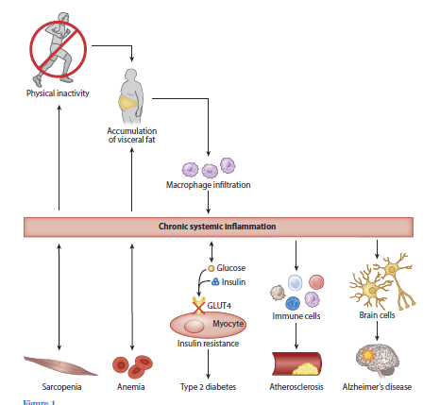
The links between the lack of physical inactivity, abdominal adiposity, inflammation, and disease
Pedersen, 2018, Annual Review of Physio

Slide 15
Recent literature
Physical activity is associated with a range of health benefits, and its absence can have harmful effects on health and well being, increasing the risk for coronary heart disease, diabetes, certain cancers, obesity, hypertension and all cause mortality (CDC 1996)
Physical inactivity may also be associated with the development of mental disorders: some clinical and epidemiological studies have shown associations between physical activity and symptoms of depression and anxiety in cross-sectional and prospective-longitudinal studies (Goodwin 2003; Motl et al. 2004)
Exercise is an integral part in the treatment and rehabilitation of many medical conditions. Improving physical well being may also lead to improved psychological well being and is generally accepted that physical activity may have positive effects on mood and anxiety

Slide 16

Exercise and neurotrophic factors
Exercise is a simple behavior that activates molecular and cellular cascades that support and maintain brain plasticity
It induces expression of genes associated with plasticity, such as that encoding Brain Derived Neurotrophic Factor (BDNF), and in addition promotes brain vascularization, neurogenesis, functional changes in neuronal structure and neuronal resistance to injury
Significantly, these effects occur in the hippocampus, a brain region central to learning and memory
Some of the beneficial aspects of exercise act directly on the molecular machinery of the brain itself, rather than on general health
Physical condition has been positively related to school achievement of children and college students (Gruber, 1975),
Improvement in physical condition associated with improvement in cognitive functioning on global measures of mental functioning (Cattell Culture Fair Intelligence Test)

Slide 17
Exercise and the brain
Cardiovascular exercise make you smarter
Heart-pumping activity is also an instant mood booster and has been shown to be as effective as prescription antidepressant medicine. Exercise activates the same pathways in the brain as morphine and increases the release of endorphins, natural feel-good neurotransmitters Cardio allows natural mood-enhancing amino acid tryptophan to enter the brain
Tryptophan is a precursor to the neurotransmitter serotonin, which balances moods
It is a relatively small amino acid, and it often competes with larger amino acids to cross the blood channels into the brain. With exercise, the muscles of the body utilize the larger amino acids and decrease the competition for tryptophan to enter the brain, which makes you feel better

Slide 18

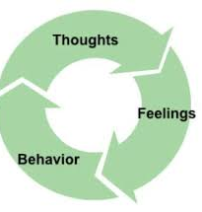
What are the mental health benefits of exercise?
Research indicates that modest amounts of exercise can make a real difference. No matter your age or fitness level, you can learn to use exercise as a powerful tool to deal with mental health problems, improve your energy and outlook, and get more out of life
Exercise and depression - Harvard T.H. Chan School of Public Health found that running for 15 minutes a day or walking for an hour reduces the risk of major depression by 26%. In addition to relieving depression symptoms, research also shows that maintaining an exercise schedule can prevent you from relapsing
Cardio exercise produces endorphins that may improve your sense of well-being and overall mood
Cardio can increase neurotransmitters like glutamate, GABA, serotonin, and norepinephrine, which may be low in depressed people
Exercise improves sleep. Going outside, changing routine, and social interaction helps mood elevation
Exercise and anxiety - It relieves tension and stress, boosts physical and mental energy, and enhances well-being through the release of endorphins
Teens who engage in physical fitness can reduce the risk of depression and suicide later in life, and even exercise as simple as walking can reduce overall symptoms of depression

Slide 19
What are the mental health benefits of exercise?
Exercise and stress – stress contracts muscles inducing back or neck pain, or painful headaches, tightness in your chest, a pounding pulse, or muscle cramps, with added problems of insomnia, heartburn, stomachache, diarrhea, or frequent urination. The worry and discomfort of all these physical symptoms can in turn lead to even more stress, creating a vicious cycle between your mind and body
Exercising is an effective way to break this cycle. As well as releasing endorphins in the brain, physical activity helps to relax the muscles and relieve tension in the body. Since the body and mind are so closely linked, when your body feels better so, too, will your mind.
Exercise and ADHD - Exercising regularly is one of the easiest and most effective ways to reduce the symptoms of ADHD and improve concentration, motivation, memory, and mood. Physical activity immediately boosts the brain’s dopamine, norepinephrine, and serotonin levels—all of which affect focus and attention. In this way, exercise works in much the same way as ADHD medications such as Ritalin and Adderall
Other mental health benefits of exercise
Sharper memory and thinking
Higher self-esteem
Better sleep
More energy
Stronger resilience

Slide 20
If exercise makes us feel so good, why is it so hard to do it?
Starting out too hard in a new exercise program may be one of the reasons people disdain physical activity
When people exercise above their respiratory threshold — that is, above the point when it gets hard to talk — they postpone exercise's immediate mood boost by about 30 minutes
For novices, that delay could turn them off from the treadmill for good.
Sports trainers suggest workout neophytes start slowly, with a moderate exercise plan
An emphasis on the physical effects of exercise also brings about apathy to activity. Physicians frequently tell patients to work out to lose weight, lower cholesterol or prevent diabetes. Unfortunately, it takes months before any physical results of your hard work in the gym are apparent
Getting started with exercise
Start small
Schedule workouts when your energy is highest
Focus on activities you enjoy
Be comfortable
Reward yourself
Make exercise a social activity
The exercise mood boost, offers near-instant gratification

Slide 21

Designing a therapeutic exercise program
A program may include exercise for improving or preventing deterioration in:
aerobic capacity
muscle strength power and endurance
flexibility or range of movement
balance, coordination, and agility
All exercise training and sport sessions should start with a 10–15-min dynamic warm-up period followed by 20–60 min of exercise training
Finally, a 10-min cool-down period with less intensive activities and stretching should end the exercise training session
Between the training sessions, there must be enough time to recover

Slide 22
Common training principles of exercise
Overload
A system must be exercised at a level beyond which it is presently accustomed for a training effect to occur
The system being exercised will gradually adapt to the overload or training stimulus being applied, and this will go on happening till the training stimulus continues to be increased until the tissue can no longer adapt
The training stimulus applied consists of different variables such as intensity, duration, and frequency of exercise
It is important to give the system being exercised enough time to recover and only apply a training stimulus again when the system is no longer fatigued (warm up and cool down)
Specificity
Any exercise will train a system for the particular task being carried out as the training stimulus. Eg: a training program including muscle strengthening will train the muscle in the range that it is working and the way that the muscle is being used, i.e. isometrically, concentrically, or eccentrically
It is important that any exercise to strengthen muscle targets the muscle range and type of muscle work specific to the task required. Eg: riding a bicycle requires concentric knee extension from mid-to inner range, as the pedal is pushed down to propel the bicycle along. Cyclist wishing to increase the strength of his quadriceps will need to train concentrically in mid-to inner range
Depending on the presenting problem, the required task should become part of the training program at an appropriate stage

Slide 23
Common training principles of exercise
Reversibility
Individuality
The beneficial effects of training begin to be lost as soon as training stops. This happens in a similar time frame as it takes to train the system
Variation in response to a training program will occur in a population as people respond differently to the same training program. This depends on the initial fitness level of the individual, their health status, and their genetic makeup
Those individuals with a lower fitness level before starting an exercise program show improvement in fitness more quickly than those who are relatively fit before training begins
Some individuals with health conditions may not be able to work at the same kind of intensity as a healthy individual and so will take longer to achieve a training goal
Safety
Whenever an individual exercise, there is a risk that they may injure themselves. Safety factors are considered here in relation to the physiotherapist. the environment and the patient or person carrying alit the exercise^{[4]}.

Slide 24
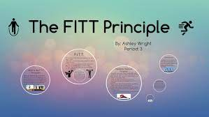
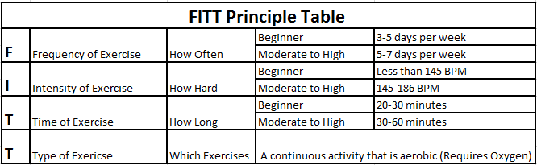
One long-term result of regular aerobic activity is cardiovascular endurance, also known as cardio-respiratory endurance. This is the ability of the body to work continuously for extended periods of time. Those who have a high level of cardiovascular fitness have lowered risks of adult lifestyle diseases, such as, type 2 diabetes, cardiovascular disease, and obesity
Cardiovascular endurance increases chances for living a longer and healthier life. It is important to know your FITT Principles so that you gain health benefits for your heart. The table below illustrates the different FITT Principles
Aerobic activities strengthen the lungs and heart and make the working muscles more efficient at using oxygen. They also increase stroke volume (amount of blood pumped per heartbeat) and lowers the resting heart rate. Increasing stroke volume is very important because it means that the heart does not have to work as hard
A resting heart rate varies from person to person, however the lower your resting heart rate, the more efficient your heart is working

Slide 25
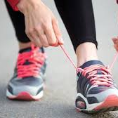
FITT PRINCIPLES
Frequency of Exercise: Cardiovascular benefits are achieved when you engage in exercise 3-5 times each week. You may gain additional benefits if you engage in an activity more frequently, but 3-5 times is the recommended range to improve general fitness
Intensity of Exercise: Intensity refers to how hard you are working. Intensity is one of the most important ways to determine if you are exercising at a level that benefits your heart. This level is called your Target Heart Rate (THR) Zone. In general, this means exercising at a level where the heart is beating between 50% and 85% of a person’s maximum heart rate (220 minus age) or approximately 142–186 BPM (average for youth)
Time (Duration) of Exercise: Time refers to how long you should C03-02A exercise in your Target Heart Rate Zone. To achieve the greatest cardiovascular benefit, a workout should be at least 20 minutes of continuous or intermittent aerobic activity per exercise session. Intermittent means that the activity should be done in blocks of time that are 10 minutes or longer. Cardiovascular benefits continue to increase as the exercise duration is extended to 60 minutes. Beyond 60 minutes of activity, cardiovascular benefits start to level off, and the risk of injury increases
Type of Exercise: Types of cardiovascular fitness exercises include rhythmical, repetitive activities that involve large muscle groups and are performed over prolonged periods. These types of activities provide the greatest improvements in cardiovascular fitness. The list of activities that fall into this category include walking, cycling, swimming, jogging, and aerobic class type activities.

Slide 26
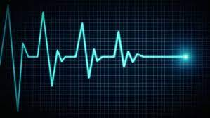
Heart Rate Percentages
Age | MHR | 50% | 60% | 70% | 80% | 90%
11 | 209 | 147 | 160 | 172 | 185 | 197
12 | 208 | 146 | 159 | 171 | 183 | 196
13 | 207 | 146 | 158 | 170 | 182 | 194
14 | 206 | 146 | 158 | 170 | 182 | 194
15 | 205 | 139 | 152 | 165 | 178 | 192
16 | 204 | 138 | 151 | 164 | 178 | 191
17 | 203 | 138 | 151 | 164 | 177 | 190
18 | 202 | 137 | 150 | 163 | 176 | 190

Slide 27
Thank you

Slide 28
Buffer slides

Slide 29
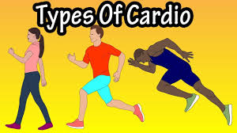
What is meant by Cardiovascular exercise?
Cardiovascular fitness relates to the body’s ability to generate energy and deliver oxygen to working muscles. It is considered the most important component of physical fitness and is one of the best indicators of overall health. Aerobic exercises are best for developing cardiovascular fitness. Aerobic means “with oxygen” and includes continuous activities that use oxygen. A few examples of aerobic activities are walking, biking, jogging, and skating. These types of exercises sustain oxygen to the muscles for an extended time period

Slide 30
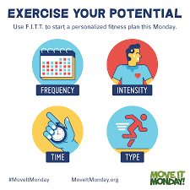
Aerobic (cardiorespiratory endurance)capacity
The dose of exercise can be described using the so-called FITT factors, where FITT stands for Frequency, Intensity, Time, and Type of activity
The same principle could be used endurance training to dose a load
Some individuals may not respond as expected because of individual variability in the magnitude of response to a particular exercise regimen
Furthermore, the FITT principle of exercise may not apply in certain cases because of individual characteristics (e.g., health status, physical ability, age) or athletic and performance goals
Accommodations to the exercise should be made for individuals with clinical conditions and healthy individuals with special considerations
ACSM recommends to use the FITT method

Slide 31
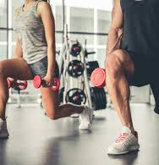
Frequency -2-3 days a week
Intensity -one set of 8-10 RM to volitional fatigue
Duration -3 seconds for the concentric phase and 3 seconds for the eccentric phase of the activity (about 1 minute in total)
A general strengthening program would include 8-10 exercises that target all the major muscle groups in the body
Resistance training (RT) is an effective method to improve muscular strength, power, and hypertrophy which are fundamental components of physical fitness related to the quality of life
STRENGTH TRAINING

Slide 32
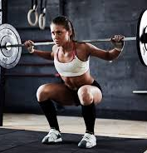
Research over the last few decades has investigated the effects of several acute training variables on maximal strength gains that influence the overall outcome of an RT program
These RT variables include exercise order, the number of sets, repetitions, inter-set recovery periods, training intensity per muscle group, and total training volume

